Slide 1




Don’t pity on yourself
He is out of his mind!

Slide 2

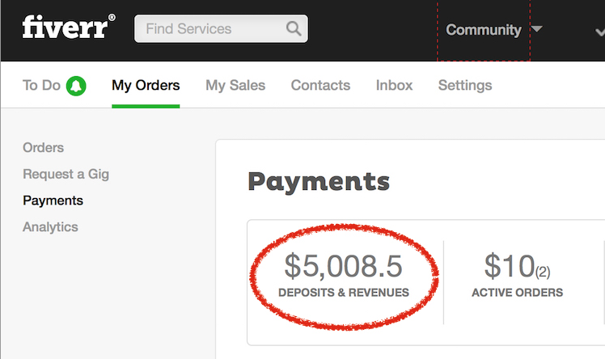




How to Create a Gig On Fiverr/Upwork
A Step-by-Step Guide

Slide 3
Fiverr is the biggest and most popular freelance marketplace. After signing up with Fiverr, you have the option to either become a seller or a buyer. Thousands of buyers visit Fiverr every day to hire freelance workers. And according to Fiverr, a gig is bought every 3 seconds. So, If you’ve never made a cent online, Fiverr is always the easiest place to start.
Fiverr is totally free to use.
Freelancing
3

Slide 4

But before you start selling, there’s a need to create a seller profile. Popularly called a ‘Fiverr gig’. So please don't waste your time. Click on the below button and sign up now

Slide 5

What is a gig on Fiverr?
A Fiverr gig is a term commonly used to describe the service you sell on Fiverr. It provides you with the opportunity to showcase your unique talent and inform buyers that you are well and truly capable of completing the service you render.
Since you are mostly dealing with buyers whom you’ve never met before, the only way they can discover your quality is through your gig.

Slide 6
How to Create a gig on Fiverr?
The Fiverr mobile app doesn’t have a built-in feature for gig creation. So you need to log in to your Fiverr account using a computer.
Follow the steps to create a gig:

Slide 7
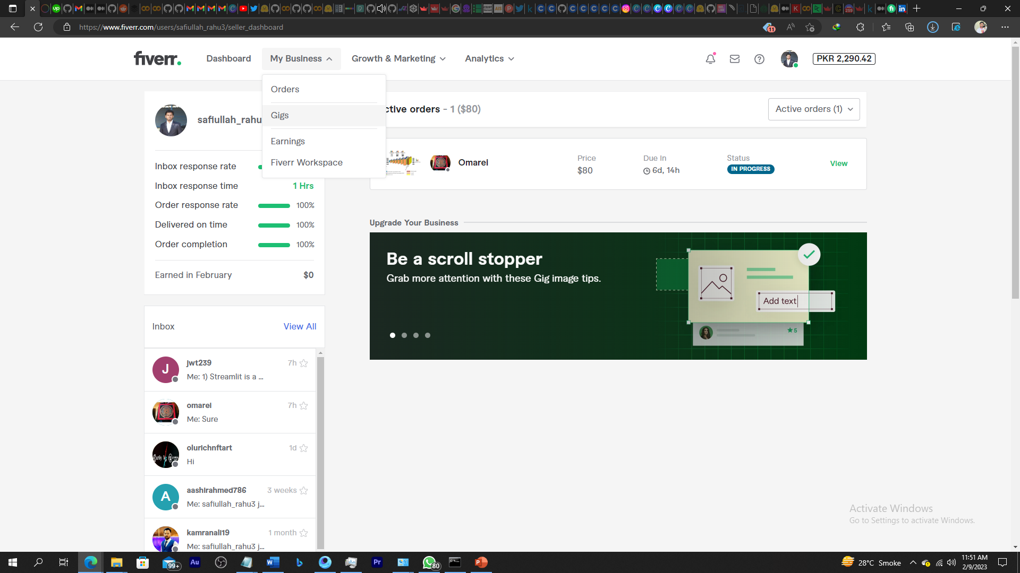


How to Create a gig on Fiverr?
Step#01: On your Fiverr homepage, click on My Business and then on Gigs.

Slide 8
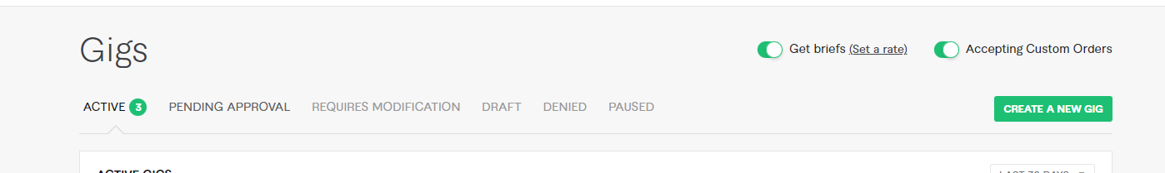

How to Create a gig on Fiverr?
Step #2: Click on create a new gig
If you’ve not created one, you’ll be prompted to do so. Click on ‘create a new gig’, found at the top-right corner.

Slide 9
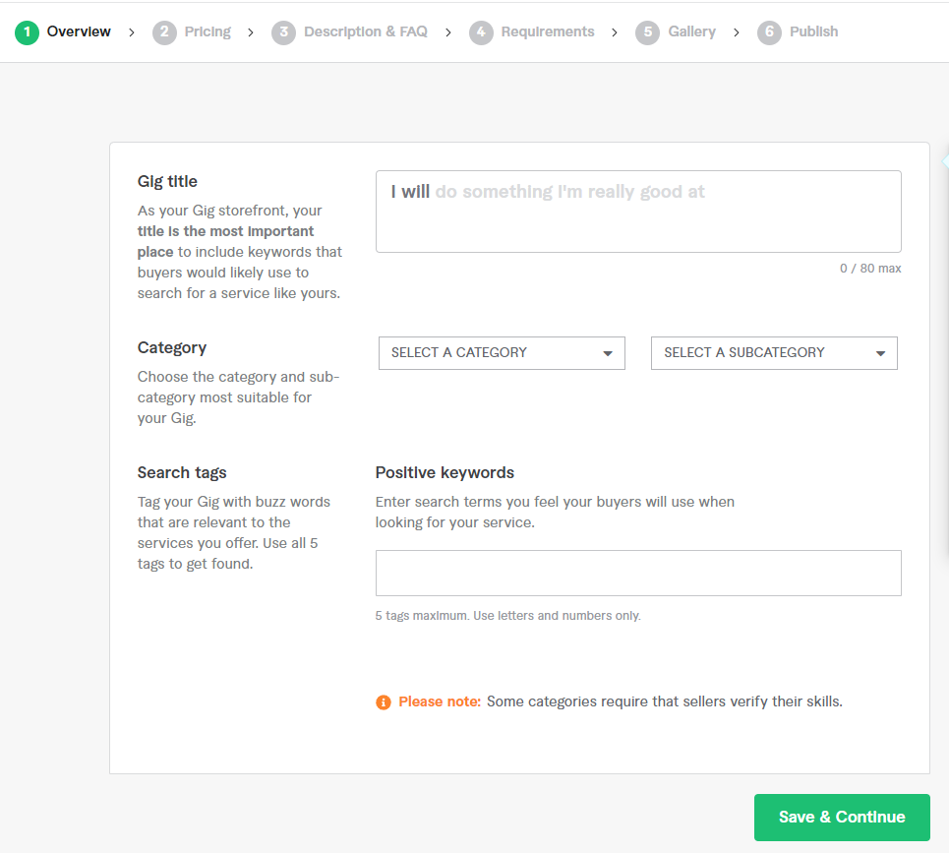
How to Create a gig on Fiverr?
Step #3: Create a Gig title, select category and meta tags.
E.g., Title: 1. I will do machine learning
Data science NLP based application like ChatGPT
2. I will do free machine learning, data science, dl, nlp, data mining project in python
3. I will do nlp, data science, machine learning, deep learning projects
4. I will build advanced natural language processing models
5. I will do your bert and gpt based natural language processing task
Confused about gig ideas? Fiverr sellers currently list over 3 million gigs. You can get ideas by browsing through the gigs of other sellers in your category.

Slide 10
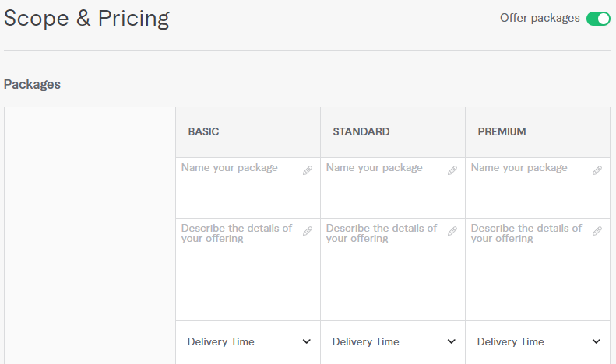
How to Create a gig on Fiverr?
Step #4: Set your gig pricing and packages.
Basic: Simple Machine Learning Algorithm Implementation or Debugging in the code. (D2,R1)
Standard: Data Wrangling, Exploratory Data Analysis, Modeling of Machine/Deep Learning Project (D4, R2)
Premium: Full Documentation, Feature Engineering, Complex Machine/Deep Learning Model Building (D6, R3)
Your gig pricing has a base price of $5 and can be set to as high as $995. Also, you can unlock other packages for the same gig.

Slide 11
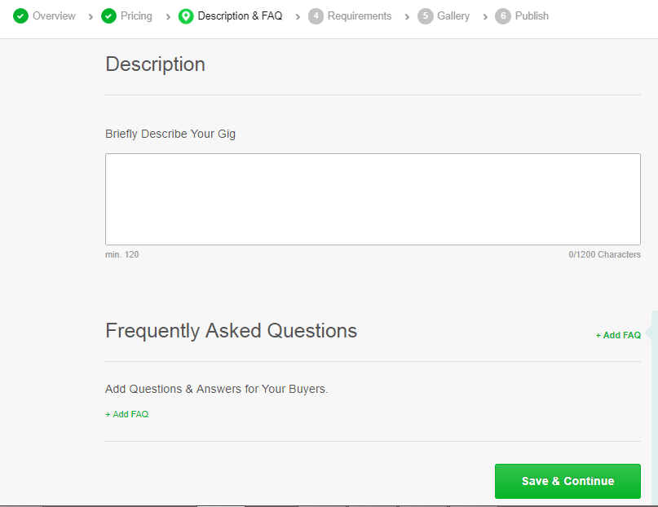
How to Create a gig on Fiverr?
Step #5: Write a gig description and FAQ
After your gig title, your gig description is the next most important thing about your gig.
Many new sellers on Fiverr create their gig descriptions hastily. That shouldn’t be the case with you; Be calm and put a lot of details into your gig description, and avoid grammatical and spelling errors.
Browse through gigs of expert or top sellers in your category, and learn from their gig descriptions. However, you must ensure never to copy their gig descriptions word-for-word. If you do that, Fiverr may demote your gig ranking and deprive your gig of search visibility.

Slide 12
How to Create a gig on Fiverr?
Step #5: Write a gig description and FAQ
Unlock the Power of Data Science and Machine Learning with Expert Python Services!
Do you need help with your next data science or machine learning project? Look no further! With my 4 years of experience, I am here to provide you with top-notch solutions that will help you extract insights and make informed decisions. From customized chatbots to advanced deep learning techniques, I've got you covered.
My expertise includes:
Machine and deep learning projects from scratch
Data processing and visualization
NLP projects with BERT, FLAN-T5, and GPT
Time series analysis for stock prediction and forecasting
Hyperparameter tuning for machine learning algorithms like logistic regression, decision trees, and more
When you choose me, you can expect:
On-time delivery, every time
Quality work with detailed comments in the code
100% original, plagiarism-free solutions
24/7 availability and open communication
Prioritizing your satisfaction
Don't settle for anything less than the best. Contact me now to discuss your project and get started on your freelancing journey!

Slide 13
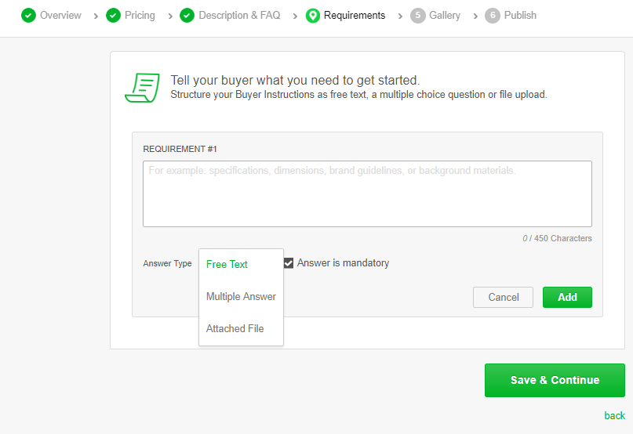
How to Create a gig on Fiverr?
Step #6: Enter Requirements
Before you get started with any work, you need to properly understand what that work is all about.
Ensure you tell your buyers to communicate, in detail, everything you need to get started. So as to avoid future disputes.
E.g., Kindly provide all the requirements for this project.

Slide 14
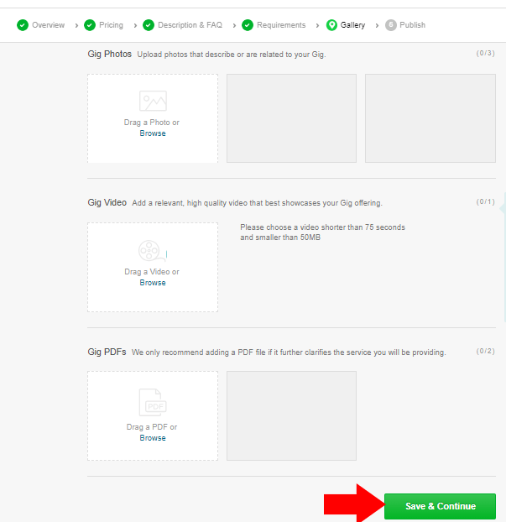
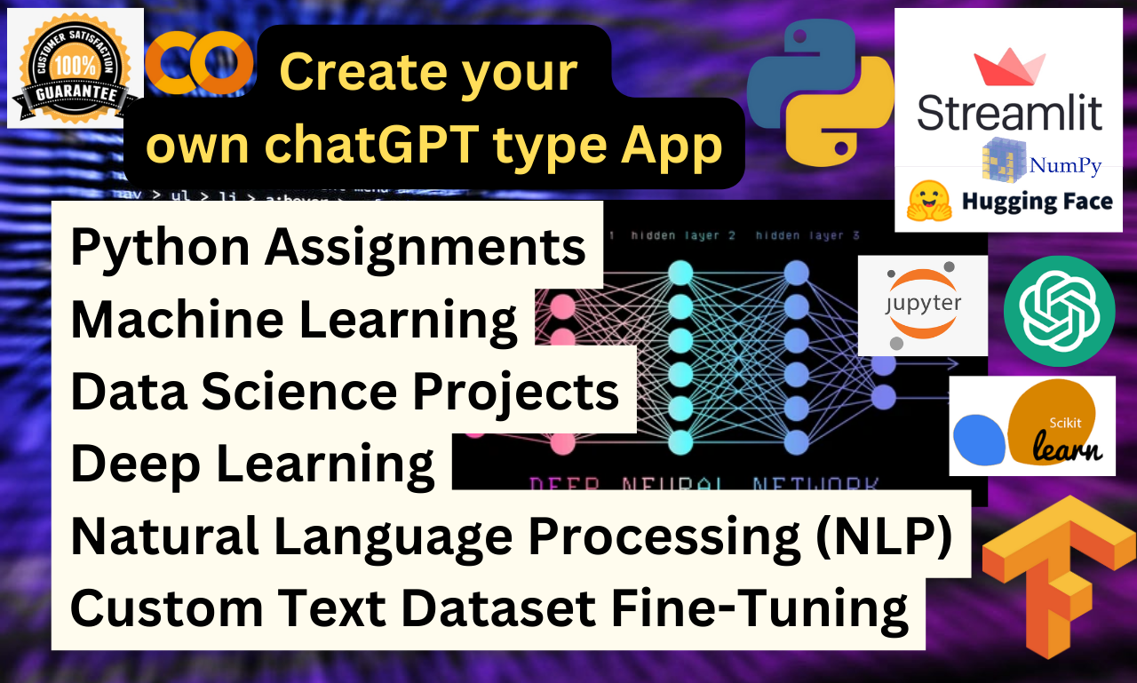
How to Create a gig on Fiverr?
Step #7: Add photos or a video to your gig
Fiverr provides you with the option to add up to 3 categories of gig galleries. You can either add an image, video or PDF file if it applies to your services.
If possible, I recommend you use a high-quality video of yourself. Buyers are more likely to buy from you if you have a gig video.

Slide 15
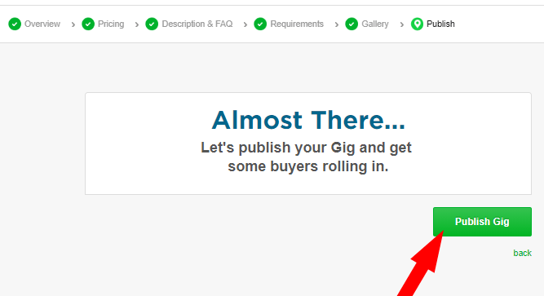
How to Create a gig on Fiverr?
Step #8: Publish your gig
The final step in launching your Fiverr gig is to publish it.
Once you hit the "publish gig" button, your gig will be live and accessible to buyers searching for freelancers in your field.
This concludes the process of creating a gig on Fiverr. If you found this guide helpful, please feel free to share it with others who may be interested in starting a gig on Fiverr.

Slide 16
Next, we will create an Upwork Seller Account
16

Slide 17
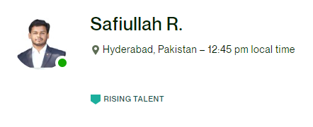
Rising Talent When you are new to Upwork, the Rising Talent badge will let clients know you are among the best new freelancers in the Upwork marketplace. To qualify for the Rising Talent Badge, you must: - Have a 100% complete profile with signs of great experience prior to joining Upwork - Have positive performance on Upwork, including submitting high-quality proposals and being selected for jobs
17

Slide 18
Upwork Profile Description
My name is Safiullah Rahu, an expert Machine Learning Developer with a knack for creating and executing state-of-the-art ML models and algorithms. Skilled in deep learning, natural language processing, and computer vision, I am proficient in programming languages such as Python and MATLAB/C.
Staying abreast with the latest advancements in Machine Learning and Artificial Intelligence is a passion for me, I am constantly exploring new techniques and models and applying them to real-world problems.
With a broad range of experience across multiple projects, including image and speech recognition, NLP, and predictive modeling, I have also worked on computer vision and object detection projects for industries such as healthcare, finance, and e-commerce.
Dedicated, hardworking, and always eager to learn, I am committed to delivering top-notch work and providing excellent customer service. I am confident that my skills and experience make me a strong candidate for any ML-related project.

Slide 19
Q&As
Well folks, that's a wrap!
Now it's time to go out there and put this newfound knowledge to use, or just forget about it all and binge watch Netflix. Your call.

